Slide 1
Theoretical Study of Stratified Photon Mapping with Kernel
Evert Andrés Buzón Badillo

Slide 2
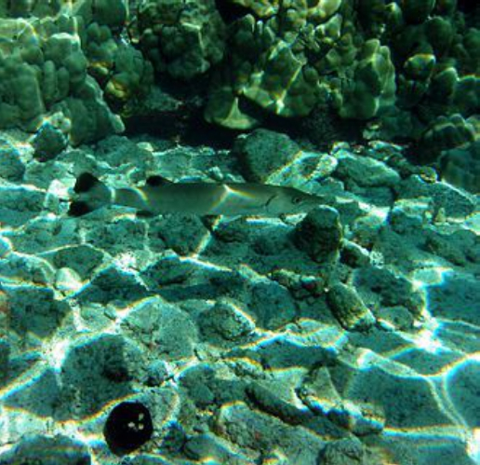
Photon Mapping
Global illumination technique that consists of two parts:
Photon map (data structure).
Irradiance estimation (rendering).
First algorithm capable of efficiently simulate
caustics.
Faster than other algorithms, but it needs more
memory.
Caustics generated by the interaction between light and the surface of water. Author: Brocken Inaglory, https://en.wikipedia.org/wiki/File:Great_Barracuda,_corals,_sea_urchin_and_Caustic_(optics) _in_Kona,_Hawaii_2009.jpg

Slide 3

Irradiance estimation
Irradiance I() is the flux φ per unit area.
Irradiance estimation by the k nearest photons.
Biases in the estimation.
$$Î\left(r_{k}\right)=\frac{kφ}{πr_{k}^{2}}$$

Slide 4

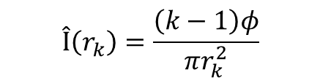
Over- and under- estimation biases
Firstly reported by Dr. Rubén García [2].
The biases manifest when estimating the irradiance.
Can be eliminated for random sampling.
Can be eliminated for stratified sampling with kernels?
$$Î\left(r_{k}\right)=\frac{kφ}{πr_{k}^{2}}$$
$$Î\left(r_{k}\right)=\frac{\left(k−1\right)φ}{πr_{k}^{2}}$$

Slide 5
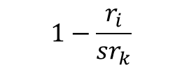
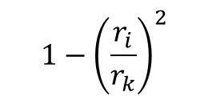

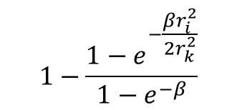
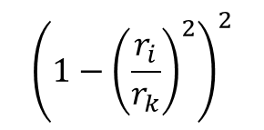
Kernels
Epanechnikov:
$$1−{\left(\frac{r_{i}}{r_{k}}\right)}^{2}$$
Cone
/Triangle:
$$1−\frac{r_{i}}{sr_{k}}$$
s = 1
Silverman:
Gaussian:
$$1−\frac{1−e^{−\frac{βr_{i}^{2}}{2r_{k}^{2}}}}{1−e^{−β}}$$
$${\left(1−{\left(\frac{r_{i}}{r_{k}}\right)}^{2}\right)}^{2}$$
$$β = 1.953$$

Slide 6
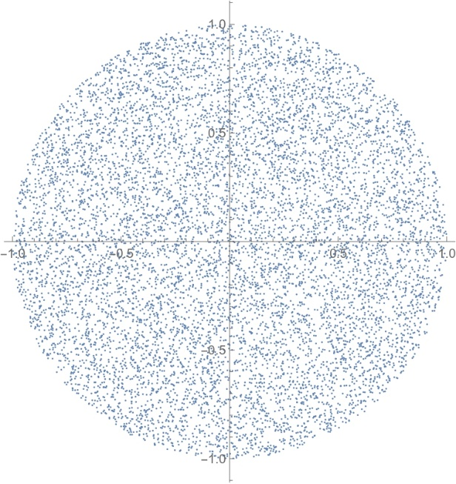
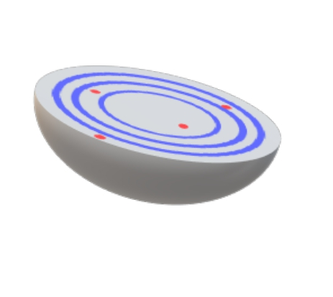
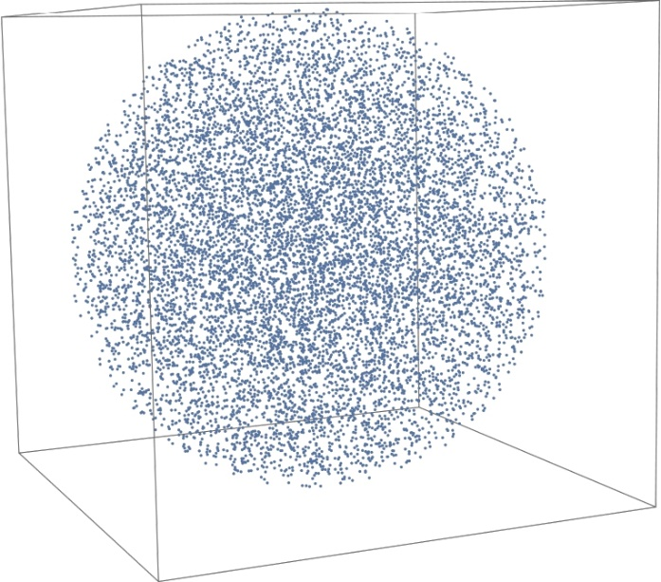
Stratification
Basic stratification, as described in [5].
Basic stratification strategy 2D for 10 000 photons.
Basic stratification strategy 3D for 10 000 photons.

Slide 7
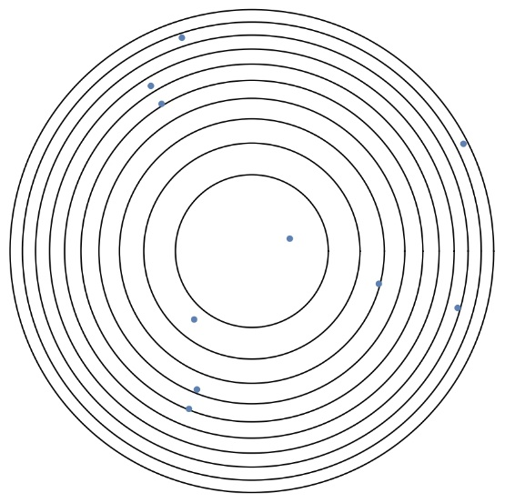


Experiment
Irradiance estimate for a point P in the center.
Directional light source.
Real irradiance at P is I(P).
The radii of the strata:
2D
$$t\left(i\right)=\sqrt{i/n}$$
Graphical representation of the experiment with basic stratification strategy for 10 rings, programmed in Mathematica. Extension of the experiments in [3] and [5].
3D
$$T\left(i\right)=\sqrt[3]{i/n}$$

Slide 8
Study of the biases
Theoretical study:
Source of the biases.
Possible solution (if any).
Empirical study:
Observe biases.
Compare results.

Slide 9
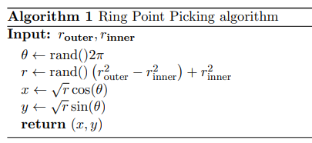


Optimizations
$$Distance\left(i,n\right)=\sqrt{\left(i−1+rand\left(\right)\right)/n}$$
2D
$$Distance\left(i,n\right)=\sqrt[3]{\left(i−1+rand\left(\right)\right)/n}$$
3D
Ring Point Picking algorithm, modification of the Direct Disk Point Picking method described in [10].

Slide 10



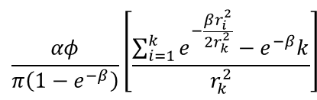

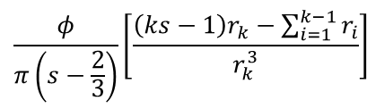
Optimizations
Epanechnikov:
Cone:
Silverman:
Gaussian:
$$\sum_{i=1}^{k}{\frac{2φ\left(1−{\left(\frac{r_{i}}{r_{k}}\right)}^{2}\right)}{πr_{k}^{2}}}$$
$$\frac{2φ}{π}\left[\frac{\left(k−1\right)r_{k}^{2}−\sum_{i=1}^{k−1}{r_{i}^{2}}}{r_{k}^{4}}\right]$$
$$\frac{φ}{π\left(s−\frac{2}{3}\right)}\left[\frac{\left(ks−1\right)r_{k}−\sum_{i=1}^{k−1}{r_{i}}}{r_{k}^{3}}\right]$$
$$\frac{3φ}{π}\left[\frac{−2r_{k}^{2}\left(\sum_{i=1}^{k}{r_{i}^{2}}\right)+\sum_{i=1}^{k−1}{r_{i}^{4}}+\left(k+1\right)r_{k}^{4}}{r_{k}^{6}}\right]$$
$$\frac{αφ}{π\left(1−e^{−β}\right)}\left[\frac{\sum_{i=1}^{k}{e^{−\frac{βr_{i}^{2}}{2r_{k}^{2}}}}−e^{−β}k}{r_{k}^{2}}\right]$$
$$α=1.728$$

Slide 11
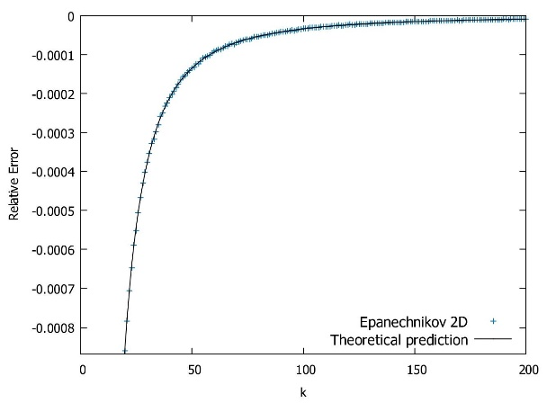
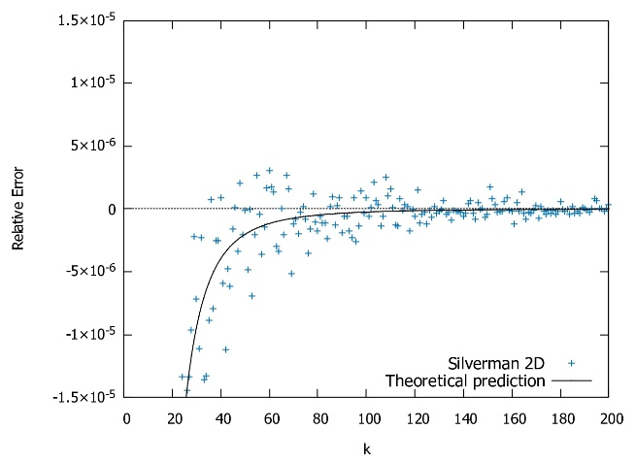
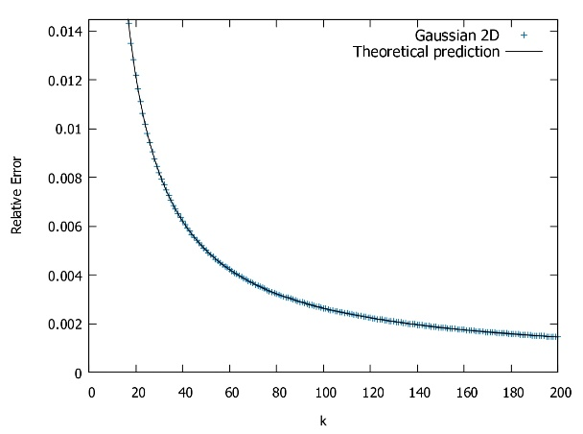
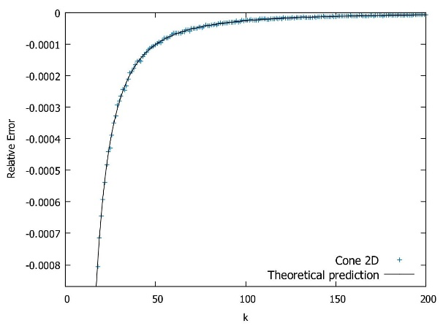
Simulation 2D

Slide 12

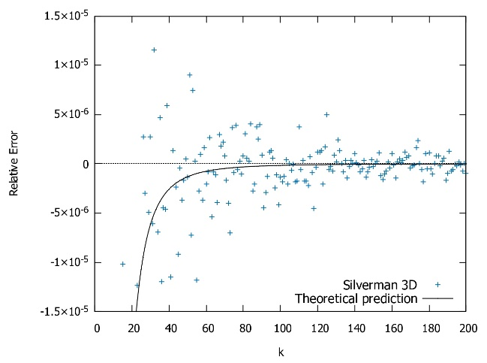
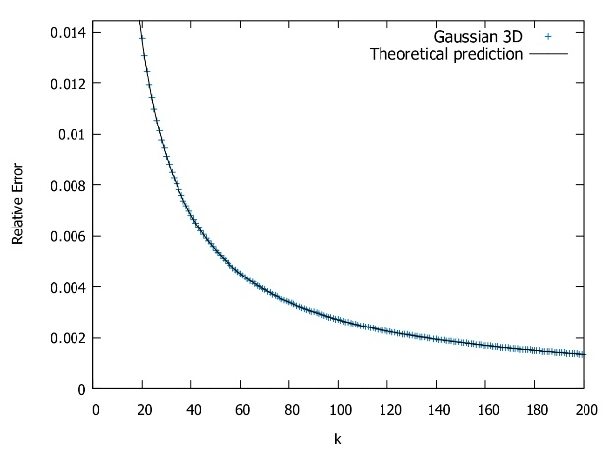

Simulation 3D

Slide 13
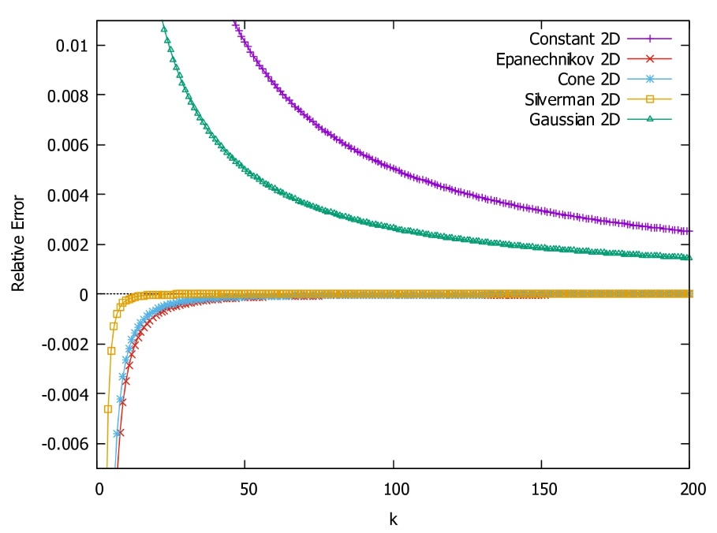
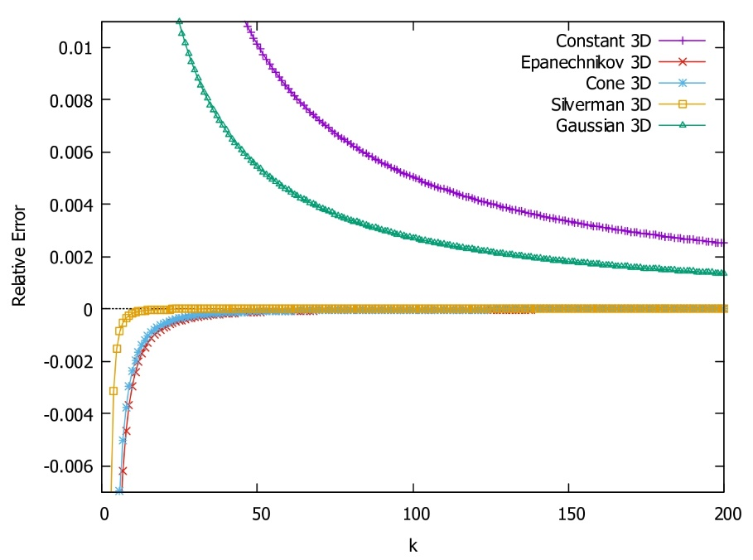
Comparison 2D vs 3D

Slide 14
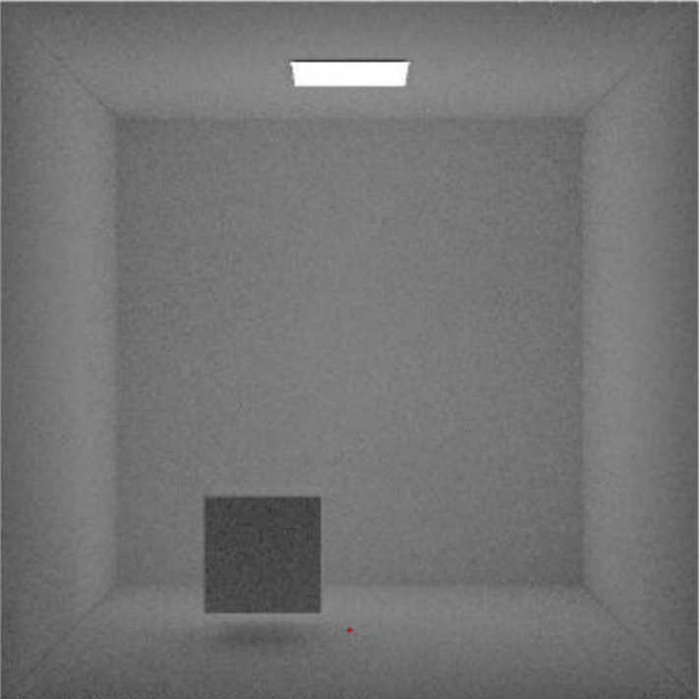
Cornell Box
Original code for a constant kernel and random sampling was provided by
Dr. Rubén García.
Illustration of Cornell Box scene.

Slide 15
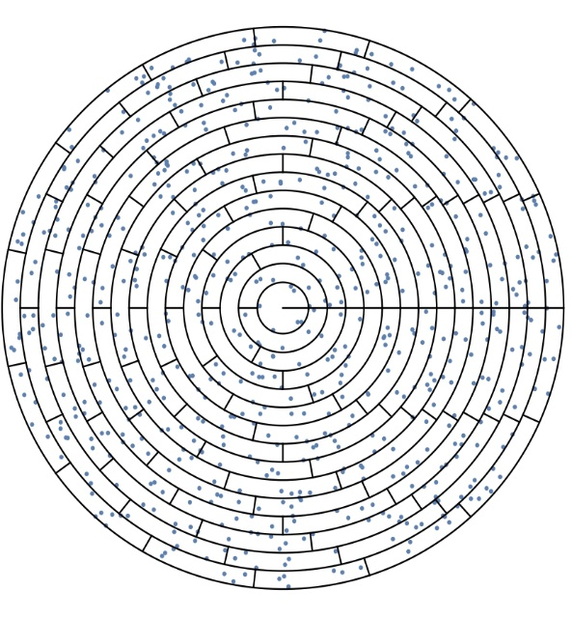
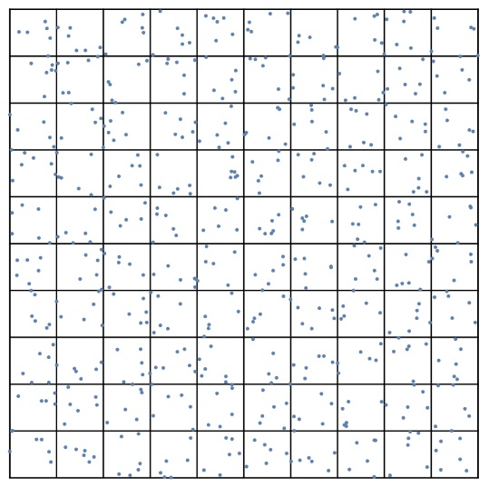
Stratification strategies
Square strategy
Disk strategy

Slide 16
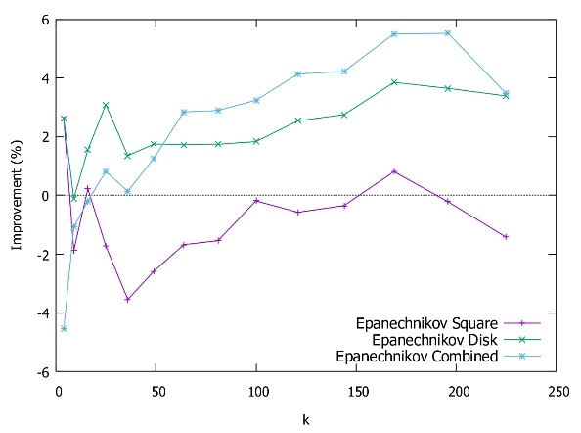
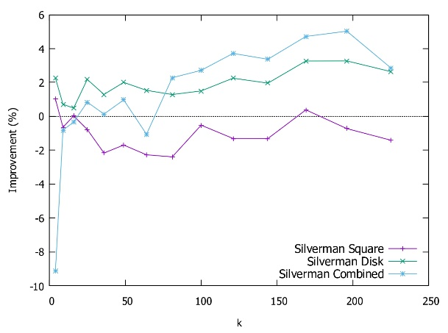
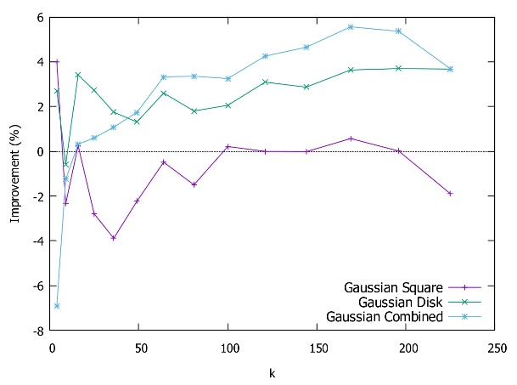
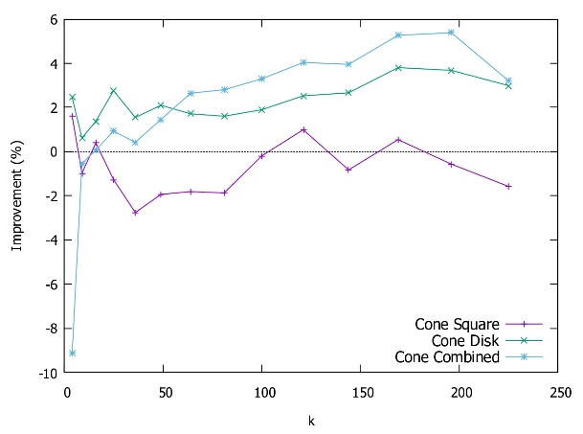
Simulation

Slide 17
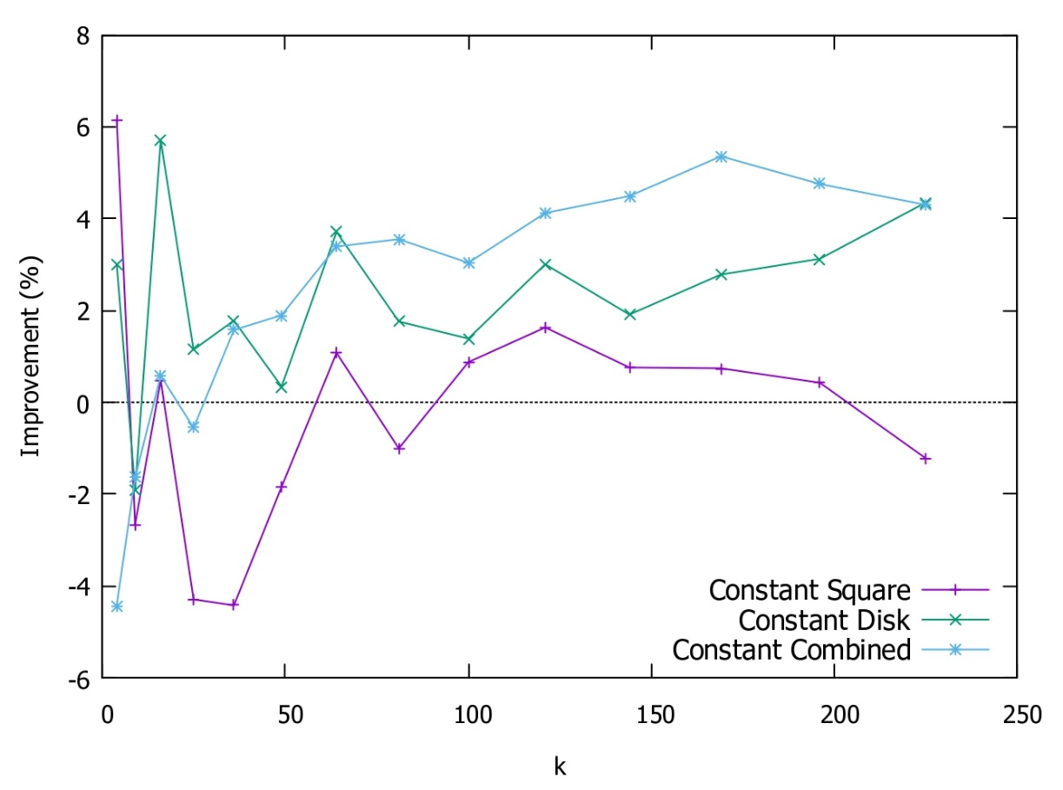
Simulation

Slide 18
Conclusions and future work
Conclusions:
No elimination of the biases with kernels.
Reduction of the biases when using kernels.
Improvement in standard deviation with disk and combined strategies.
Not clear improvement with the square strategy.
Future work:
General solution for the over- and under-estimation biases.
Explanation for the effects of the square strategy.
Disk strategy in other global illumination algorithms.

Slide 19
Additional material

Slide 20
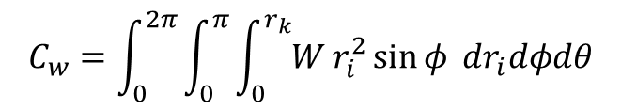
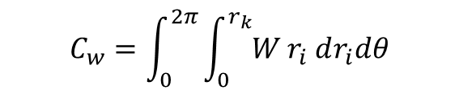
Kernel normalization
Integrate over the area or volume of group of photons.
Depends on the dimension, size and shape of the group of photons.
$$C_{w}=\int_{0}^{2π}{\int_{0}^{r_{k}}{W}r_{i} dr_{i}dθ}$$
$$C_{w}=\int_{0}^{2π}{\int_{0}^{π}{\int_{0}^{r_{k}}{W}r_{i}^{2}\sin{φ }dr_{i}dφdθ}}$$

Slide 21


Theoretical study
Model a probabilistic algorithm by expected value E[].
Calculate first for i<k and then for i=k.
$$E\left[X\right]=\int{f\left(x\right)x} dx$$
$$E\left[X+Y\right]=E\left[X\right]+E\left[Y\right]$$

Slide 22
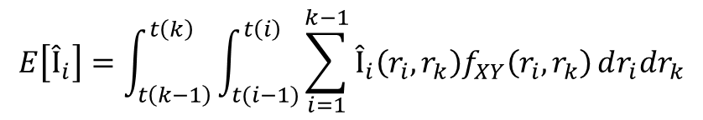

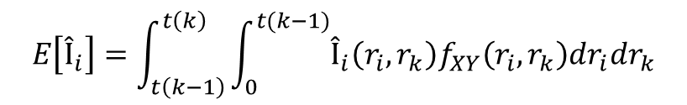
Theoretical study
i<k in 2D:
The probability density function in 2D is :
2D
$$t\left(i\right)=\sqrt{i/n}$$
$$E\left[Î_{i}\right]=\int_{t\left(k−1\right)}^{t\left(k\right)}{\int_{t(i−1)}^{t\left(i\right)}{\sum_{i=1}^{k−1}{Î_{i}\left(r_{i},r_{k}\right)f_{XY}\left(r_{i},r_{k}\right)}dr_{i}dr_{k}}}$$
$$E\left[Î_{i}\right]=\int_{t\left(k−1\right)}^{t\left(k\right)}{\int_{0}^{t(k−1)}{Î_{i}\left(r_{i},r_{k}\right)f_{XY}\left(r_{i},r_{k}\right)dr_{i}dr_{k}}}$$
$$f_{XY}\left(r_{i},r_{k}\right)=f_{X_{\left(i\right)}}\left(r_{i}\right)f_{X_{\left(k\right)}}\left(r_{k}\right)=2r_{i}n2r_{k}n=4n^{2}r_{i}r_{k}$$

Slide 23

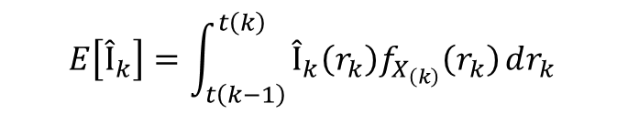
Theoretical study
i=k in 2D:
The probability density function in 2D is:
$$E\left[Î_{k}\right]=\int_{t\left(k−1\right)}^{t\left(k\right)}{Î_{k}\left(r_{k}\right)f_{X_{\left(k\right)}}\left(r_{k}\right)}dr_{k}$$
$$f_{X_{\left(k\right)}}\left(r_{k}\right)=2r_{k}n$$

Slide 24
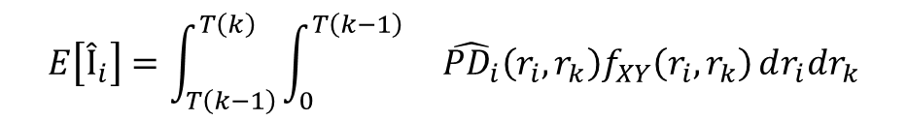

Theoretical study
For i<k in 3D is :
The probability density function in 3D is :
3D
$$T\left(i\right)=\sqrt[3]{i/n}$$
$$E\left[Î_{i}\right]=\int_{T\left(k−1\right)}^{T\left(k\right)}{\int_{0}^{T\left(k−1\right)}{}\hat{PD_{i}}\left(r_{i},r_{k}\right)f_{XY}\left(r_{i},r_{k}\right)}dr_{i}dr_{k}$$
$$f_{XY}\left(r_{i},r_{k}\right)=f_{X_{\left(i\right)}}\left(r_{i}\right)f_{X_{\left(k\right)}}\left(r_{k}\right)=9n^{2}r_{i}^{2}r_{k}^{2}$$

Slide 25

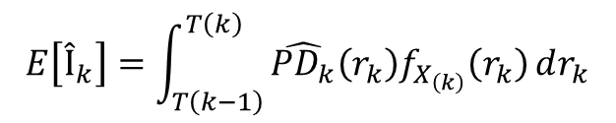
Theoretical study
i=k in 3D:
The probability density function in 3D is:
$$E\left[Î_{k}\right]=\int_{T\left(k−1\right)}^{T\left(k\right)}{\hat{PD_{k}}\left(r_{k}\right)f_{X_{\left(k\right)}}\left(r_{k}\right)}dr_{k}$$
$$f_{X_{\left(k\right)}}\left(r_{k}\right)=3r_{k}^{2}n$$

Slide 26
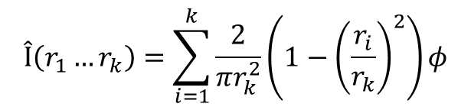
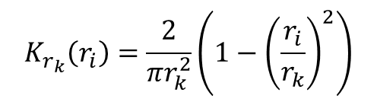
Example Epanechnikov kernel 2D
The normalized Epanechnikov kernel for a disk of radius 1 is:
The irradiance estimate is:
$$K_{r_{k}}\left(r_{i}\right)=\frac{2}{πr_{k}^{2}}\left(1−{\left(\frac{r_{i}}{r_{k}}\right)}^{2}\right)$$
$$Î\left(r_{1}…r_{k}\right)=\sum_{i=1}^{k}{\frac{2}{πr_{k}^{2}}}\left(1−{\left(\frac{r_{i}}{r_{k}}\right)}^{2}\right)φ$$

Slide 27

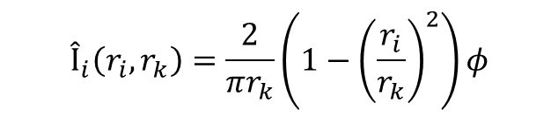
Example Epanechnikov kernel 2D
The contribution of a photon i<k is:
The contribution of a photon i=k is:
$$Î_{i}\left(r_{i},r_{k}\right)=\frac{2}{πr_{k}}\left(1−{\left(\frac{r_{i}}{r_{k}}\right)}^{2}\right)φ$$
$$Î_{k}\left(r_{k}\right)=0$$

Slide 28
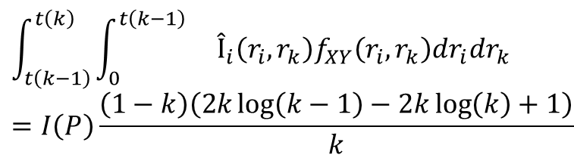
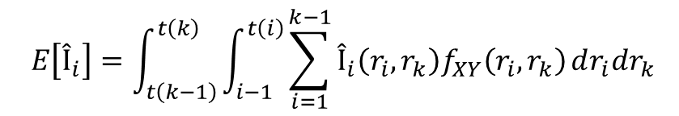
Example Epanechnikov kernel 2D
i<k:
$$E\left[Î_{i}\right]=\int_{t\left(k−1\right)}^{t\left(k\right)}{\int_{i−1}^{t\left(i\right)}{\sum_{i=1}^{k−1}{Î_{i}\left(r_{i},r_{k}\right)f_{XY}\left(r_{i},r_{k}\right)}dr_{i}dr_{k}}}$$
$$\int_{t\left(k−1\right)}^{t\left(k\right)}{\int_{0}^{t\left(k−1\right)}{}}Î_{i}\left(r_{i},r_{k}\right)f_{XY}\left(r_{i},r_{k}\right)dr_{i}dr_{k}=I\left(P\right)\frac{\left(1−k\right)\left(2k\log\left(k−1\right)−2k\log\left(k\right)+1\right)}{k}$$

Slide 29
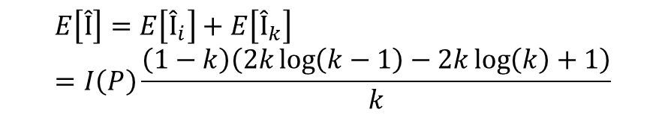
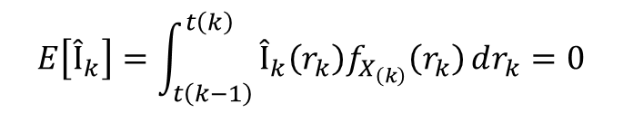
Example Epanechnikov kernel 2D
i=k:
We add both results:
$$E\left[Î_{k}\right]=\int_{t\left(k−1\right)}^{t\left(k\right)}{Î_{k}\left(r_{k}\right)f_{X_{\left(k\right)}}\left(r_{k}\right)}dr_{k}=0$$
$$E\left[Î\right]=E\left[Î_{i}\right]+E\left[Î_{k}\right]=I\left(P\right)\frac{\left(1−k\right)\left(2k\log\left(k−1\right)−2k\log\left(k\right)+1\right)}{k}$$

Slide 30
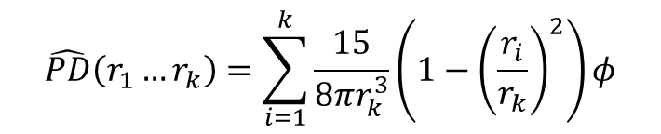
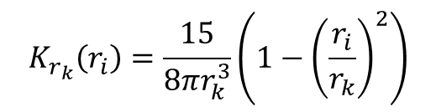
Example Epanechnikov kernel 3D
The normalized Epanechnikov kernel for a sphere of radius 1 is:
The power density estimate is:
$$K_{r_{k}}\left(r_{i}\right)=\frac{15}{8πr_{k}^{3}}\left(1−{\left(\frac{r_{i}}{r_{k}}\right)}^{2}\right)$$
$$\hat{PD}\left(r_{1}…r_{k}\right)=\sum_{i=1}^{k}{\frac{15}{8πr_{k}^{3}}}\left(1−{\left(\frac{r_{i}}{r_{k}}\right)}^{2}\right)φ$$

Slide 31
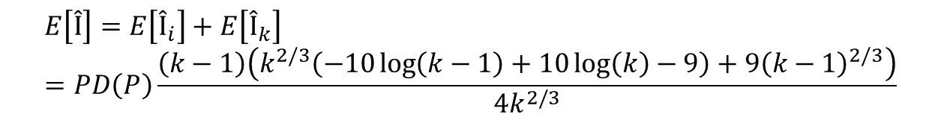
Example Epanechnikov kernel 3D
As in the 2D case, we calculate the expected values separately and then
add them together.
$$E\left[Î\right]=E\left[Î_{i}\right]+E\left[Î_{k}\right]=PD\left(P\right)\frac{\left(k−1\right)\left(k^{2/3}\left(−10\log\left(k−1\right)+10\log\left(k\right)−9\right)+9{\left(k−1\right)}^{2/3}\right)}{4k^{2/3}}$$

Slide 32
Bibliography
[1] García, R.: Estudio y desarrollo de técnicas interactivas de Iluminación Global / Study and development of interactive techniques for global illuminationl. Universidad de Granada 2009
[2] García, R. ; Urena, C. ; Sbert, M.: Describing and Solution of an Unreported Intrinsic Bias in Photon Mapping Density Estimation with Constant Kernel. . Computer Graphics Forum 31 Nr 1, 2012, pp. 33-41
[3] García, R. ; Urena, C. ; Sbert, M. ; Poch, J.:Overestimation and underestimation biases in photon mapping with non-constant kernels. IEEE Transactions on Visualization and Computer Graphics 20, Nr.10, 2014, pp. 1441-1450
[4] Gan, Zhiming: Variance of photon mapping density estimation. LudwigMaximilians Universität Munich, 2018
[5] Hartmann, Kathrin: Theoretical study of photon mapping with stratification. 2020
[6] Schaller, S.: Variance of Photon Mapping with Stratification. LudwigMaximilians Universität 2021
[7] Alexander Altland ; Jan Von Delft: Mathematics for Physicists, Introductory Concepts and Methods. Cambridge University Press, 2019, ISBN: 9781108471220
[8] Matt Pharr ; Wenzel Jakob ; Greg Humphreys: Physically Based Rendering:From Theory To Implementation. Morgan Kaufmann, 2016, ISBN: 9780128006450
[9] Mohammad Ahsanullah ; Valery B Nevzorov ; Mohammad Shakil: An Introduction to Order Statistics. Atlantis Press, 2013,
ISBN: 978-94-6239-048-5
[10] Arthur, Mark K.: Point Picking and Distributing on the Disc and Sphere. Army Research Laboratory https://apps.dtic.mil/dtic/tr/fulltext/u2/a626479.pdf
[11] Jensen, Henrik W.: Global Illumination using Photon Maps. RenderingTechniques’96, Springer-Verlag, 199, pp. 21-30 http://graphics.ucsd.edu/~henrik/papers/photon_map/global_illumination_ using_photon_maps_egwr96.pdf

Slide 33
Bibliography
[12 ]Jensen, Henrik W.: The Photon Map in Global Illumination, Ph.D. dissertation. Technical University of Denmark: Department of Planning: Graphical Communication, 1996
[13] Jensen, Henrik W.: A Practical Guide to Global Illumination using Photon Mapping. 2002
https://maverick.inria.fr/Members/Cyril.Soler/DEA/IlluminationGlobale/Papers/HWJ_PhotonMapping_Course.pdf
[14] Mike Cammarano ; Henrik Wann Jensen: Time Dependent Photon Mapping. EGRW ’02: Proceedings of the 13th
Eurographics workshop on Rendering, 2002, pp. 135-144 http://graphics.ucsd.edu/~henrik/papers/time_photon/time_photon.pdf
[15] Boning Liu ; Yan Zhao ; Xiaomeng Jiang ; Shigang Wang ; Jian Wei: 4-D Epanechnikov Mixture Regression in Light Field Image Compression .
IEEE Transactions on Circuits and Systems for Video Technology, vol. 32, Nr. 6, 2021, pp. 3906-3922
https://ieeexplore.ieee.org/stamp/stamp.jsp?arnumber=9513313
[16] Chun-Meng Kang ; Lu Wang ; Yan-ning Xu ; Xiang-Xu Meng: A survey of photon mapping state-of-the-art research and future challenges. Frontiers of Information Technology Electronic Engineering 17, 2016, pp. 185-199
[17] P. Shirley ; B. Wade ; P. Hubbard ; D. Zadeski ; B. Walter ; D.Greenberg: Global illumination via density estimation. Rendering Techniques’95,
Springer-Verlag, 1995, pp. 219-230
[18] Walter, B. J.: Density estimation techniques for global illumination, Ph.D. dissertation. 1998

